Slide 1
Physical Based Rendering
with Wave Effects
PRESENTED BY
Chenglin Liu 刘承林
He Li 李赫
Advanced Computer Graphics 2024 Fall

Slide 2
Content
01 Quick Overview
02 Showcase: Living Room
03 Showcase: Physical Phenomenon
04 Spotlight: Wave Effect
05 Showcase: Wave Effect
06 References

Slide 3
Part One
Quick Overview

Slide 4
01
Part One
Quick Overview
Real-Material
Real-Effects
Principled BSDF (Full ver.)
Volumetric Rendering (Full ver.)
Color Texture
Normal Texture
……
E
Many Special Light Sources
Alpha Shadow
Motion Blur
……
M
Real-Time
Real-Physics
P
Light Importance Sampling
Material Importance Sampling
Direct Lighting
All Customized for Each Material
With GPU Rendering
Consider the Wave Effect
Mimic the Poynting Vector
Electromagnetic Wave
……
T

Slide 5
Part Two
Showcase: Living Room

Slide 6
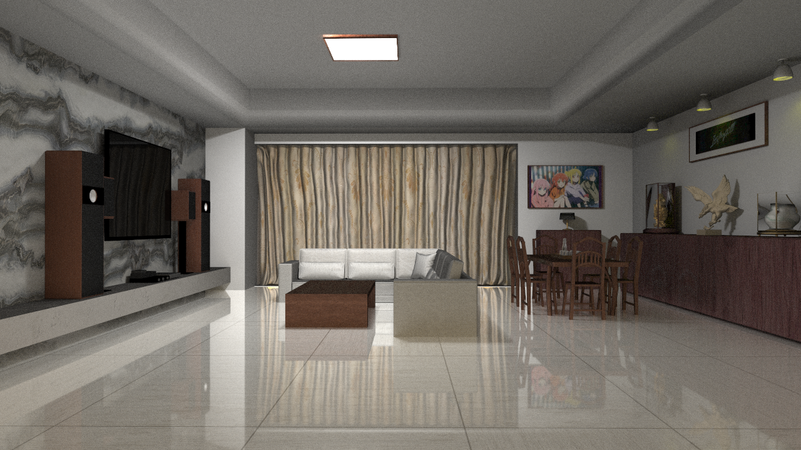
02
Part Two
Showcase: Living Room
10 FPS on 3060 laptop

Slide 7
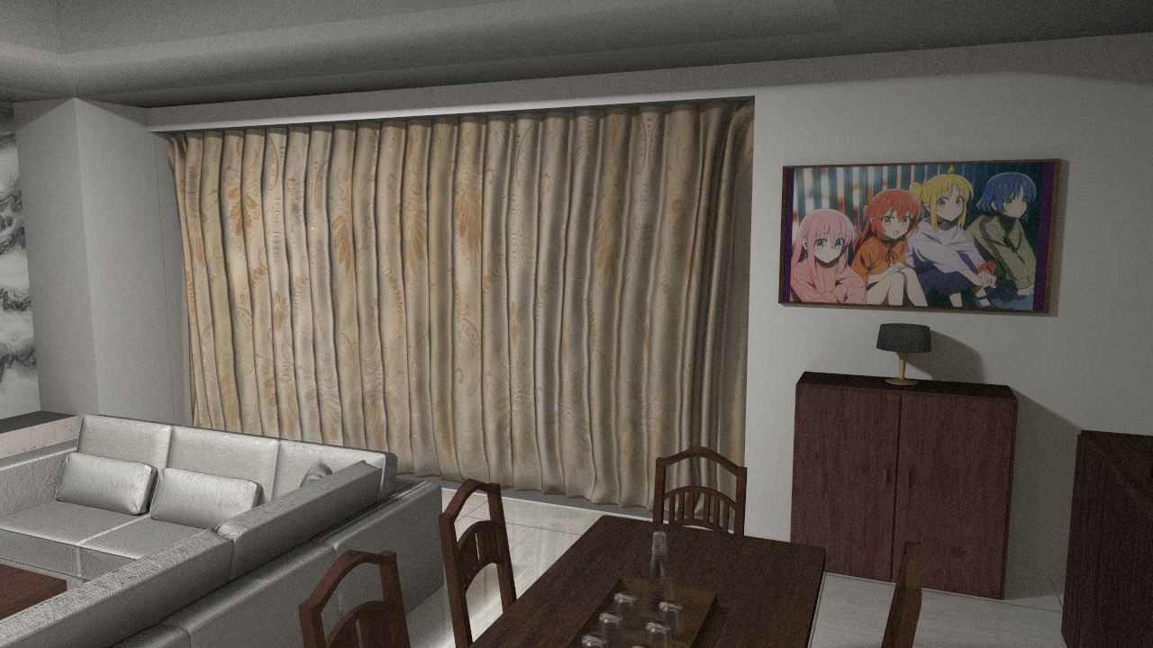
02
Part Two
Showcase: Living Room

Slide 8
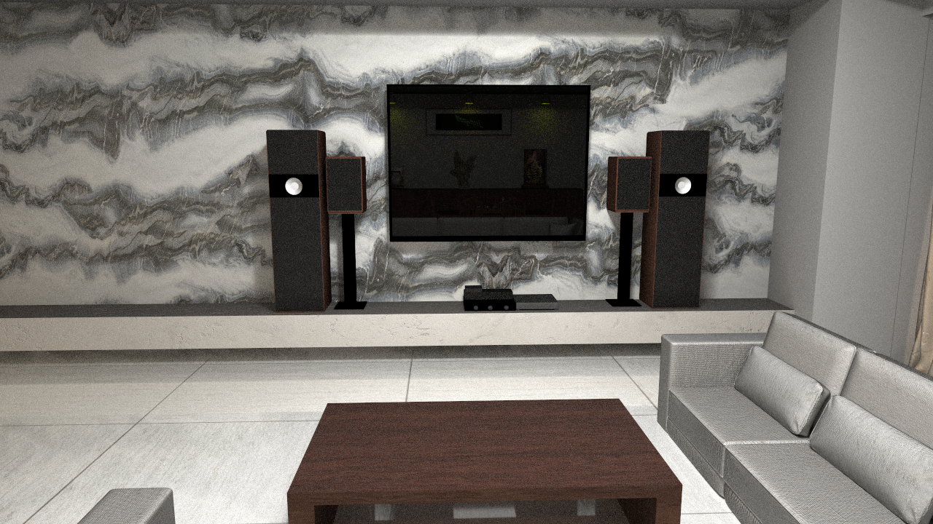
02
Part Two
Showcase: Living Room

Slide 9
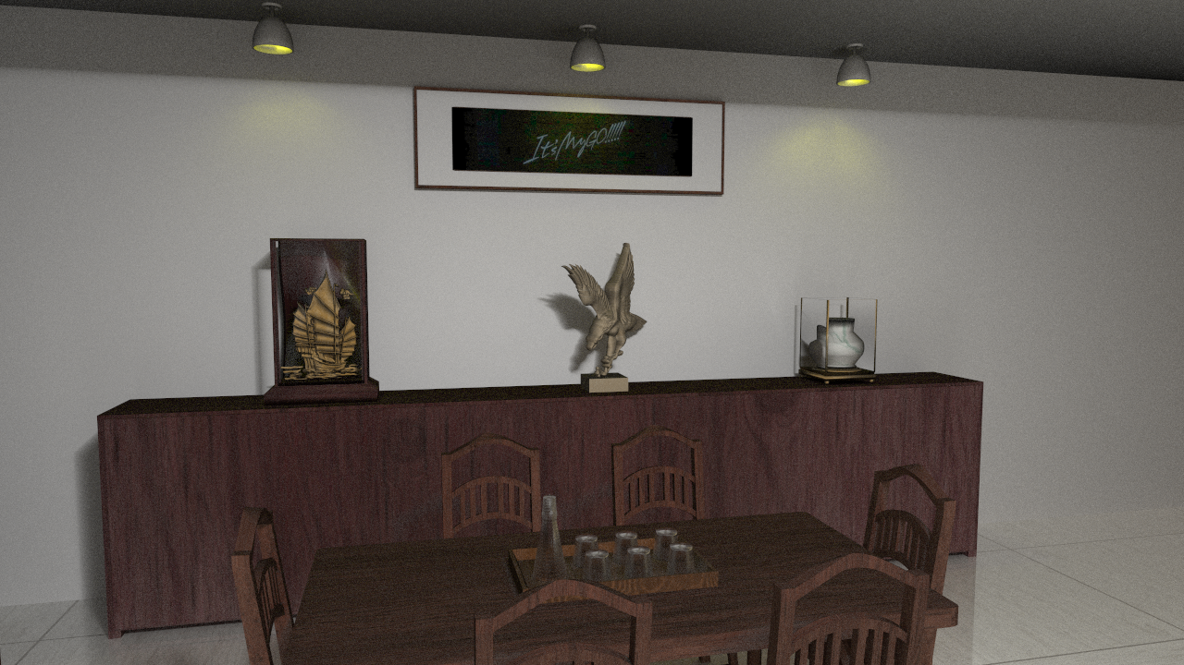
02
Part Two
Showcase: Living Room

Slide 10
Part Three
Showcase: Physical Phenomenon

Slide 11
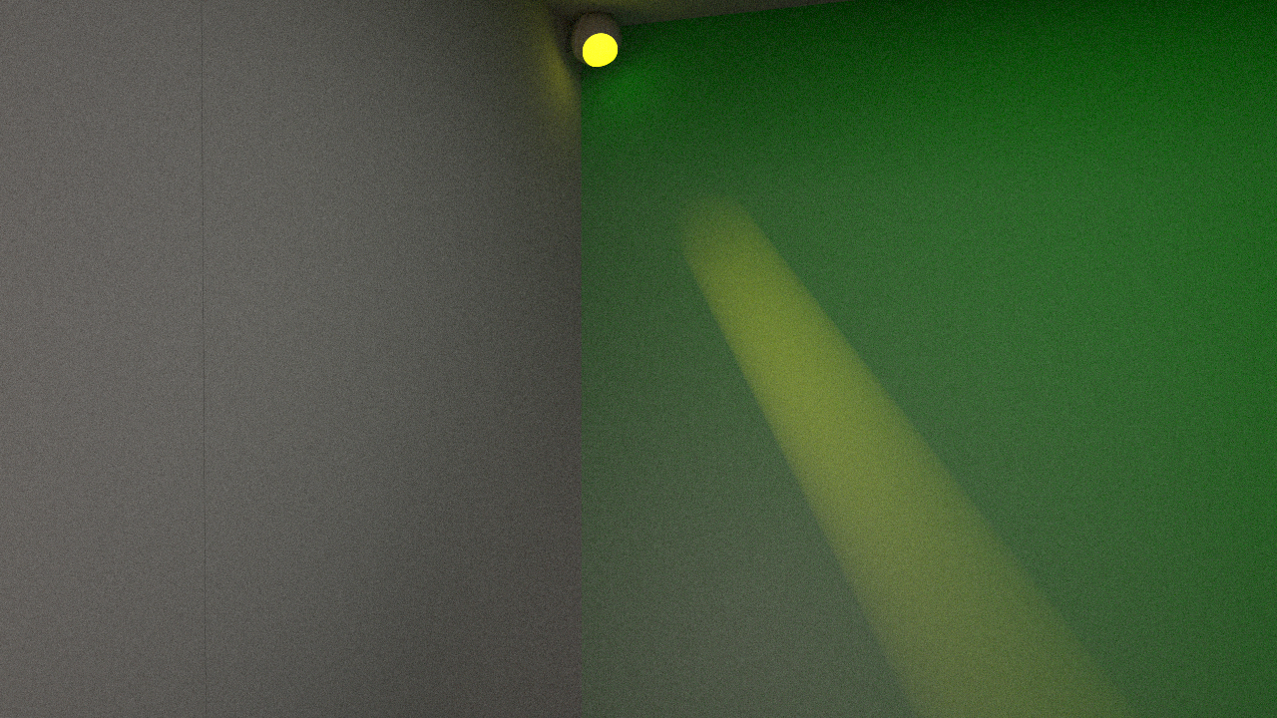
03
Part Three
Showcase: Tyndall Effect

Slide 12
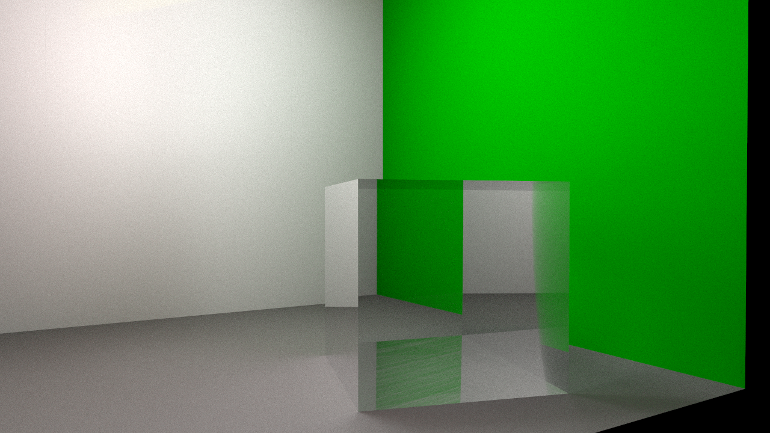
03
Part Three
Showcase: Glass
Refraction
Total Reflection
Transmission
Reflection

Slide 13
Part Four
Spotlight: Wave Effect

Slide 14
04
Part Four
Spotlight: Wave Effect
Additive Effect of Phase
Light
Is
Electromagnetic
Wave
Light has a property of phase. The accumulate effect is not simply add up the number.
Interact with Material
Transmissive material such as glass will influence the phase (namely with their IOR)
Can we embed this effect into our renderer?
Effects: Interference, Diffraction
All these properties result in some unusual phenomenon of light to common people.

Slide 15
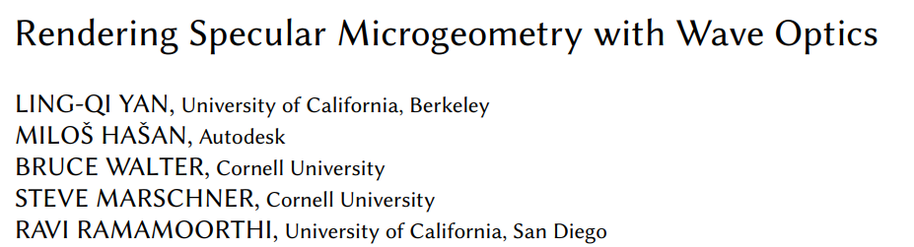
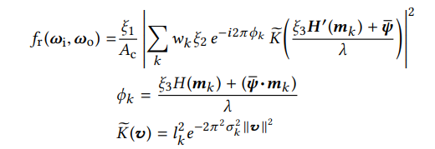
04
Part Four
Spotlight: Wave Effect
If you search for recent papers
Formula of 20 different characters,
10 of them are defined by another long formula
Published Paper by Lingqi Yan
We want to make this easier

Slide 16
04
Part Four
Spotlight: Wave Effect
Separate the RGB channel
Tracing Light with Phase
Accumulate as Vectors
Red light, green light, blue light are treated differently, such as different wavelength
1
Consider the distance that light has travelled, then calculated the phase.
2
Mimicking Poynting vector, add them up to get the real accumulated phase.
3
Simple to Implement, Fast to Converge

Slide 17
Part Five
Showcase: Wave Effect

Slide 18
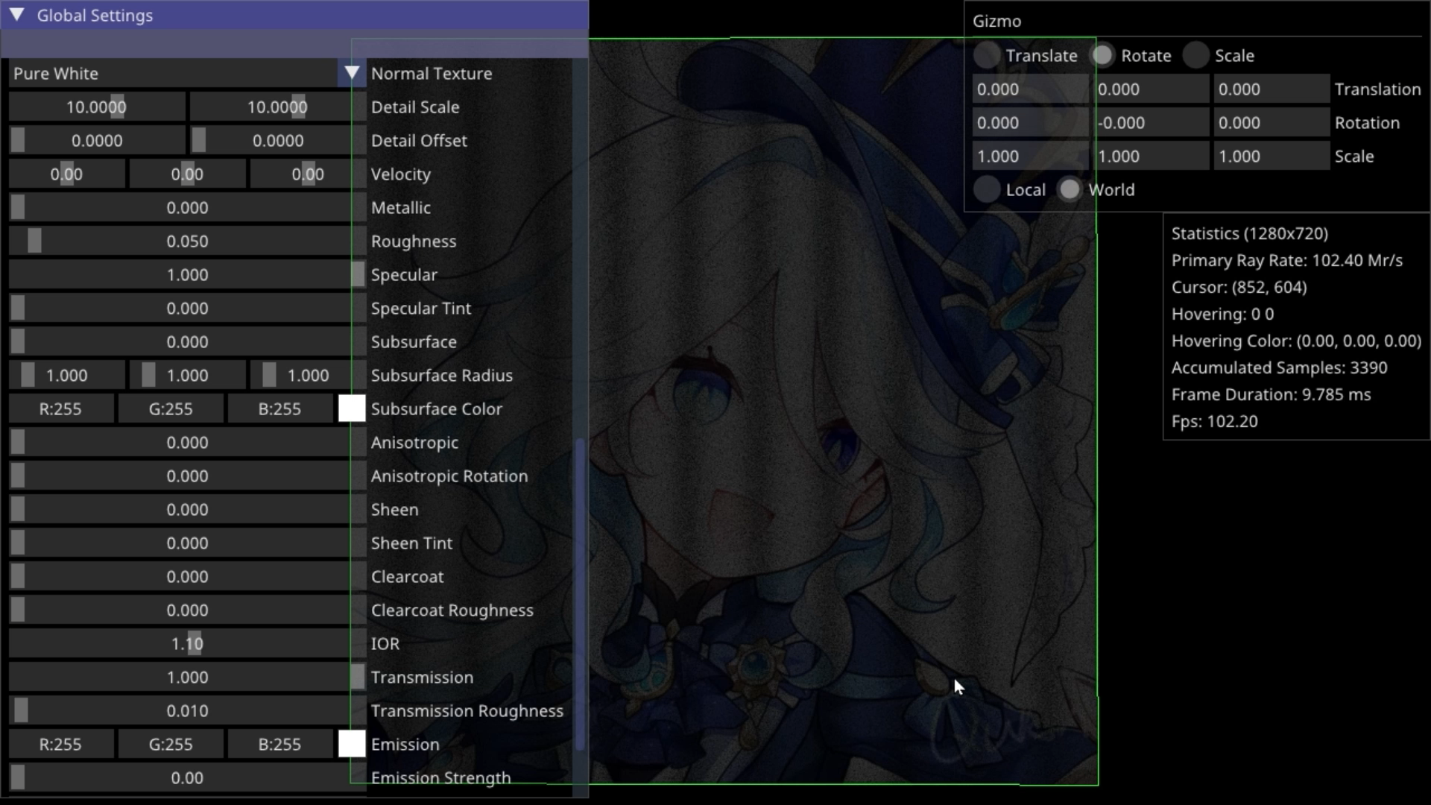
05
Part Five
Showcase: Interference with Transmissive Media

Slide 19
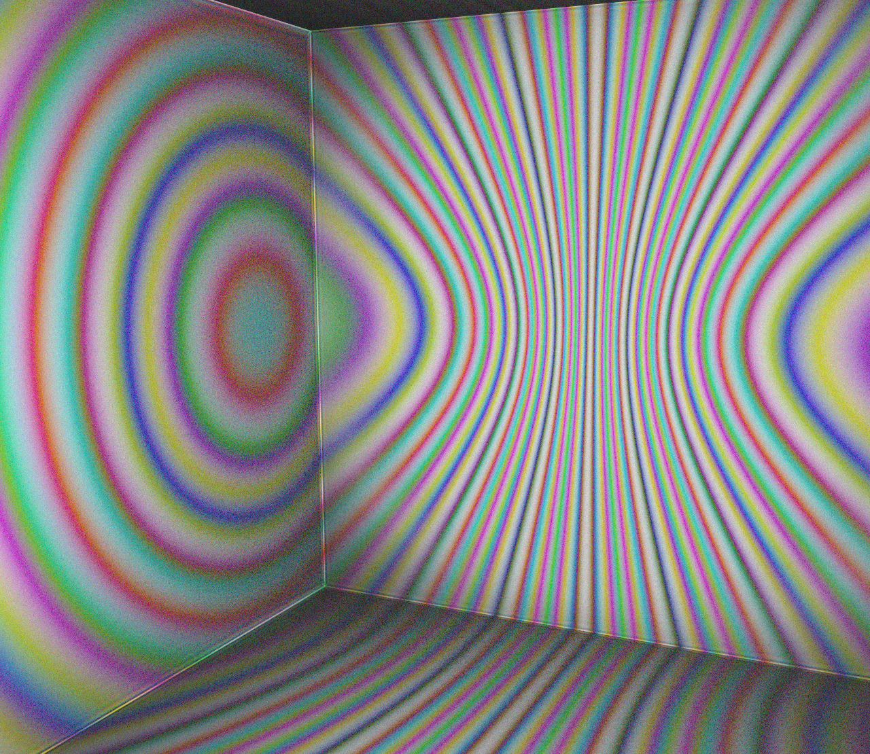
05
Part Five
Showcase: Chromatic Interference
Interference Figure on Parallel Plane
Interference Figure on Vertical Plane

Slide 20
Part Six
References

Slide 21
06
Part Six
References
1. Living Room Model
https://www.aplaybox.com/details/model/LHx6XomTBdtM
2. Rendering Specular Microgeometry with Wave Optics
https://cseweb.ucsd.edu/~ravir/waveoptics.pdf3.

Slide 22
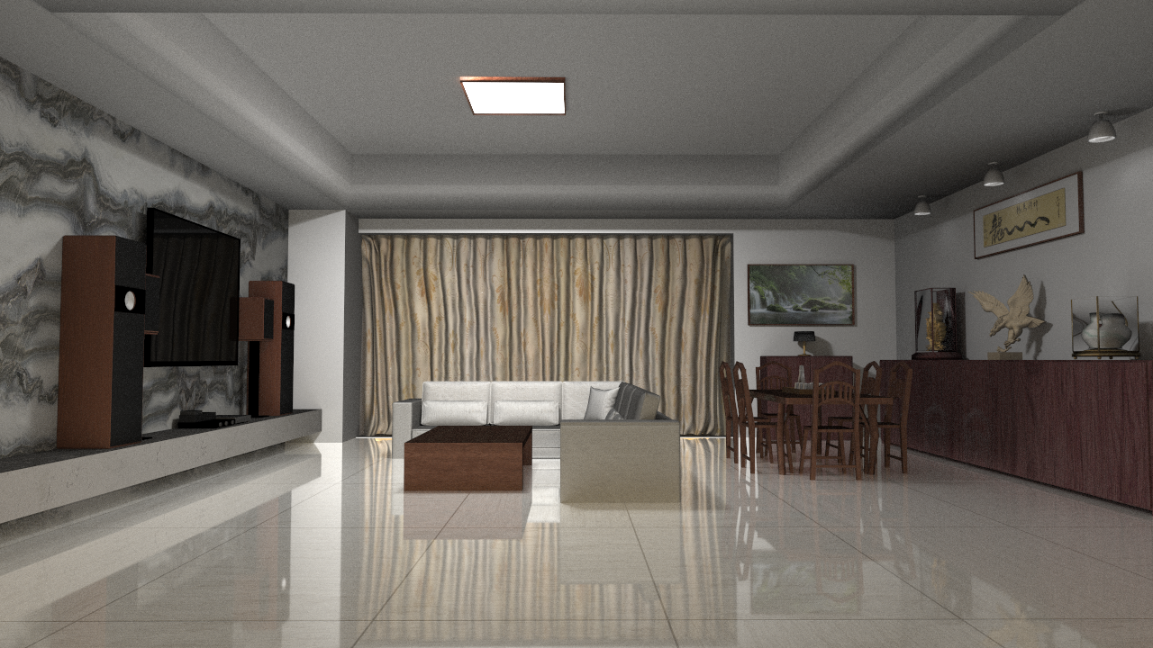
THANK YOU FOR WATCHING
Physical Based Rendering with Wave Effects
Chenglin Liu 刘承林
He Li 李赫

